Slide 1

NYC Airbnb Price Prediction
IE7275: Data Mining for Engineers
Nethra Narayanan
Preshanth Adhini Ramesh
Group 19

Slide 2
Table of contents
01
05
02
06
03
07
Objectives
Model Building
Data Description
Results & Insights
Data Pre-Processing
Challenges & Proscpects
04
Exploratory Data Analysis

Slide 3
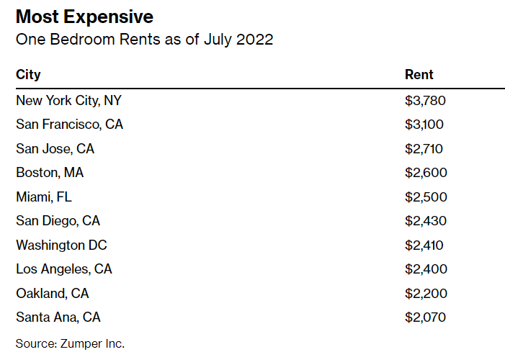
01 Objectives
In this era, everything in life runs in and around periodical getaways and just thinking about the concept of travelling in The USA leads us to the one primary attraction, New York.
The city of New York runs predominantly on temporary housing due to popular demand and this necessity is majorly satisfied by Airbnb.
Our objective is to predict the price of a given listing in NYC by considering all primary features selected through the process of Data mining.

Slide 4
02 Data Description
Data Source:
The source of the data is publicly available on the insideairbnb website.
Data Dimensions:
The dimensions of the data are 25740 rows and 75 columns amongst which there were 42 numerical values, 28 objects and 5 Date columns

Slide 5
02.1 Feature Description
Numerical Variables:
Categorical Variables:
Fig.1 Numerical variables of the dataset
Fig.2 Categorical variables of the dataset

Slide 6
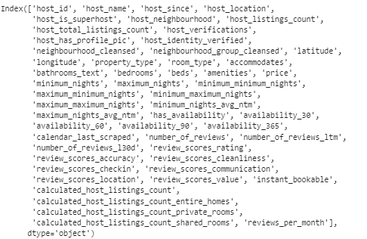
03 Data pre-processing
Manually dropped few columns which consisted of redundant data such as URL’s which had no direct effect on the price.
Dropped columns with more than 35% missing values.
Handled extreme outliers in the target variable by dropping them.
All other missing values were imputed using the median of the column.
The columns retained after initial data preprocessing are as follows:
Fig.3 Features retained after initial data preprocessing

Slide 7
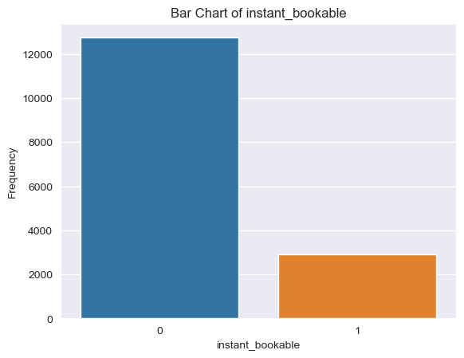
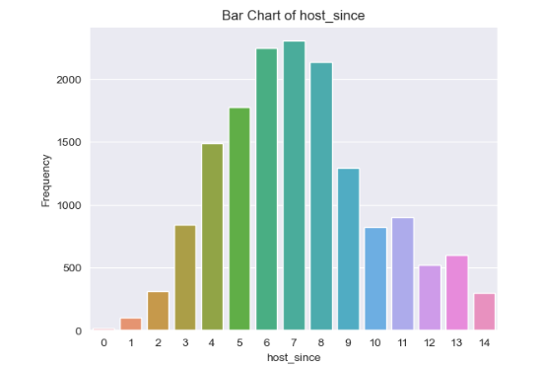
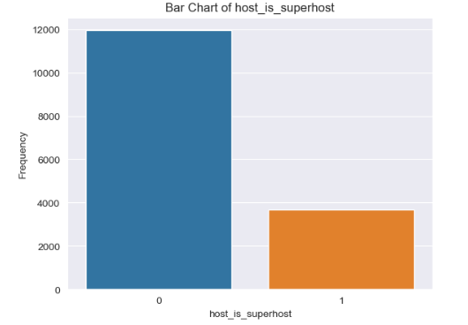
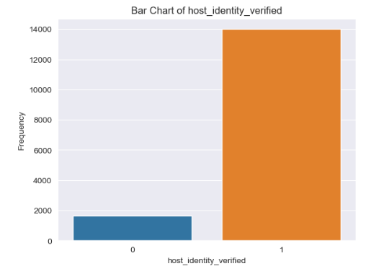
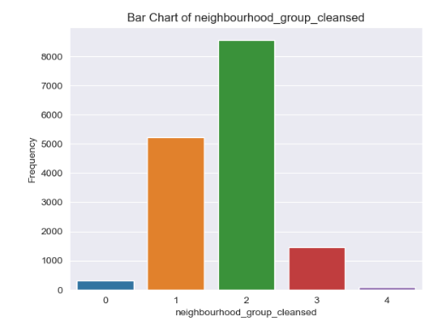
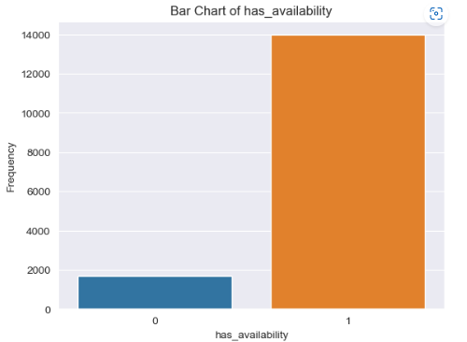
04 Exploratory Data Analysis
Categorical Variables:
Fig.4 Visual analysis of categorical variables

Slide 8
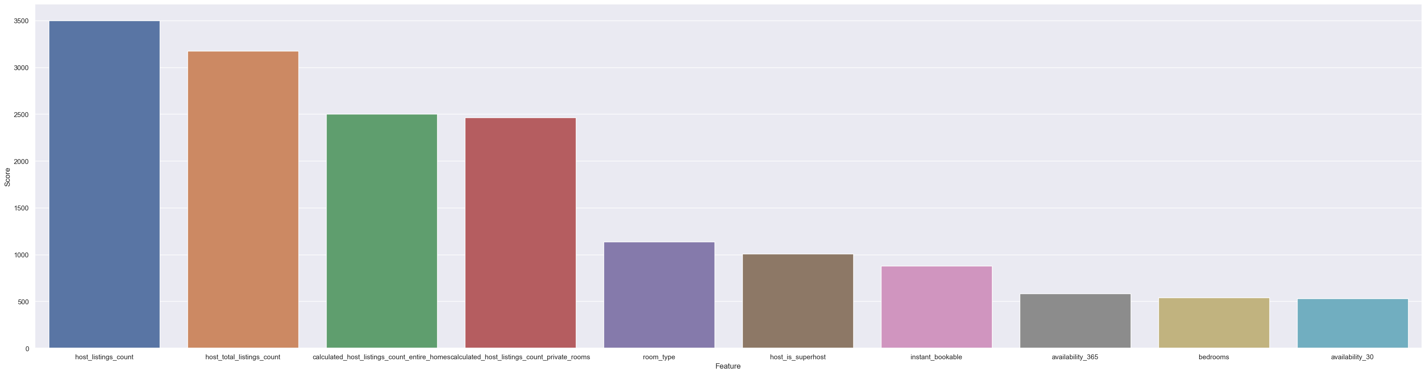
Univariate Analysis:
The top 10 features listed based on univariate analysis are visualized as follows:
Fig.5 Top 10 features based on univariate analysis

Slide 9
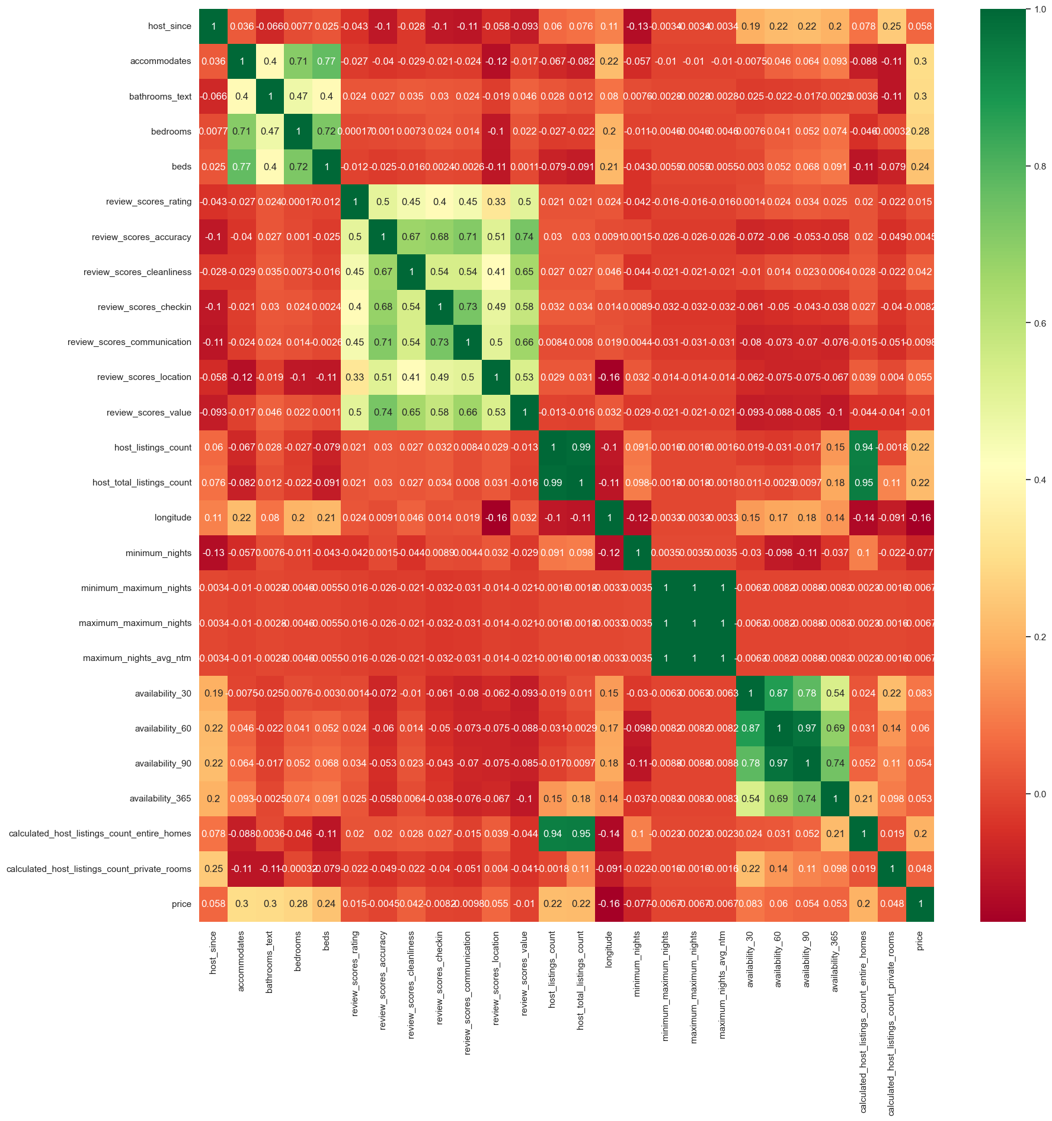
Correlation Analysis based on heatmap:
Fig.6 Correlation heatmap of the numerical variables

Slide 10
Correlation Analysis based on heatmap:
Based on the correlation values, the features beds and accommodates are highly correlated to each other with a correlation value of 0.74 and thus dropped accommodates.
Similarly, calculated_host_listings_count_entire_homes and host_listings_count have a correlation of 0.95, and hence dropped calculated_host_listings_count_entire_homes

Slide 11
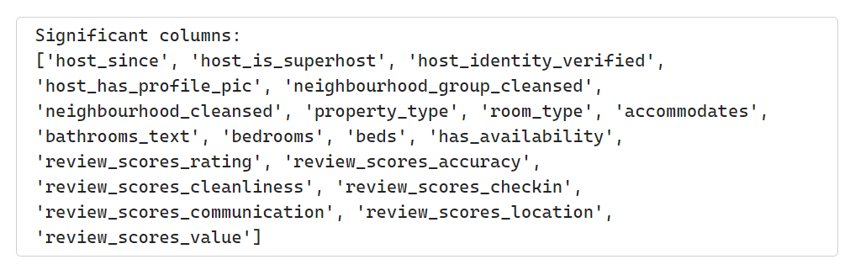
Handling Categorical Variables
We have performed ANOVA test with alpha = 0.05 for the categorical variables in our dataset, with the target variable.
This helped us scrutinize the significant features by filtering with p-value below the threshold from which we narrow down on the significant variables
We then proceeded to perform label encoding on these variables for future modelling.
Fig.7 Significant columns based on statistical test

Slide 12
05 Model Building
Data Partitioning:
We split the data into 80% training and 20% test.
The independent variables are stored in the variable X and the target variable is stored in y.
X_train contains records and features and X_test contains records and features.
y_train contains records and featured and y_test contains records and features.

Slide 13
We selected the following seven models to predict the target variable. The reason for choosing these models was because they are proven to be the best predictive models for a regression problem and testing these models helped us infer which would best suit our dataset.
Linear Regression
Ridge
Lasso
Support Vector Regressor
Random Forest Regressor
Decision Tree Regressor
XGBRegressor

Slide 14
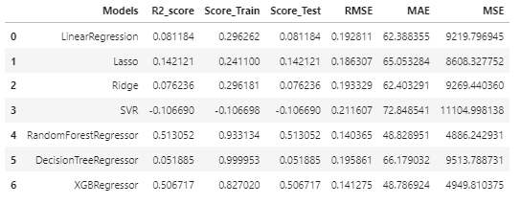
Fig.8 Model Evaluation scores
Through this process, we were able to evaluate the existence of nonlinearity in the dataset and thus Linear Regressor, Lasso, SVR and Ridge did not perform well in comparison to the other three models.

Slide 15
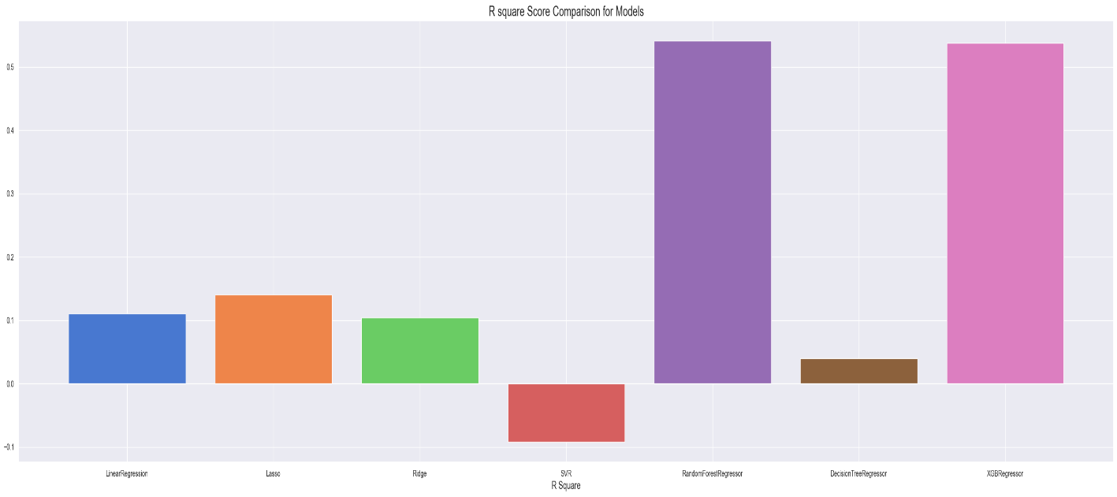
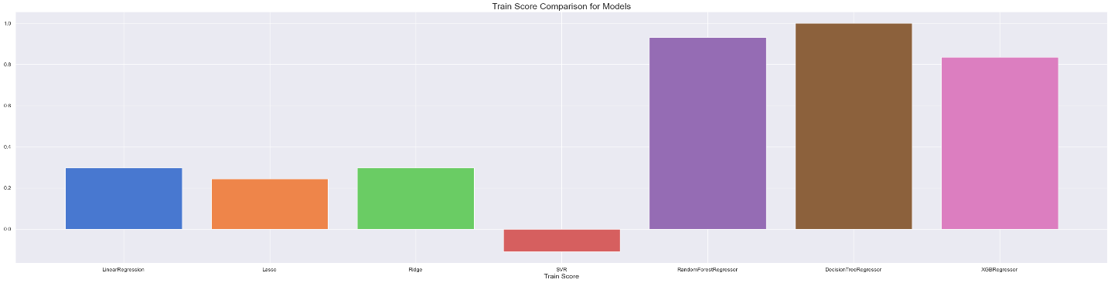
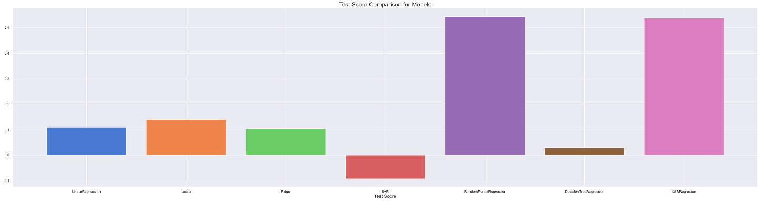
R squared comparison graph, Train and test Scores:
Fig.9 R2 scores of the models
Fig.10 Train scores of the models
Fig.11 Train scores of the models
Through all the above measures, Random Forest Regressor and XGBRegressor outperform the other models.

Slide 16
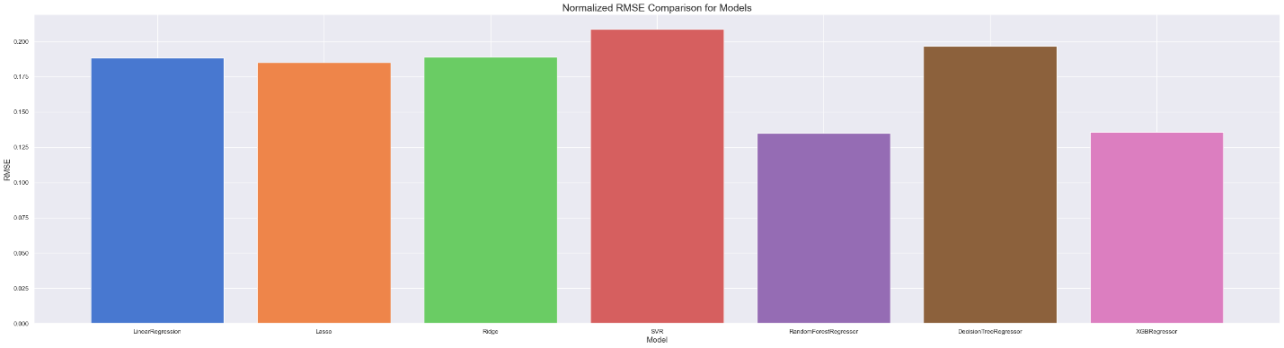
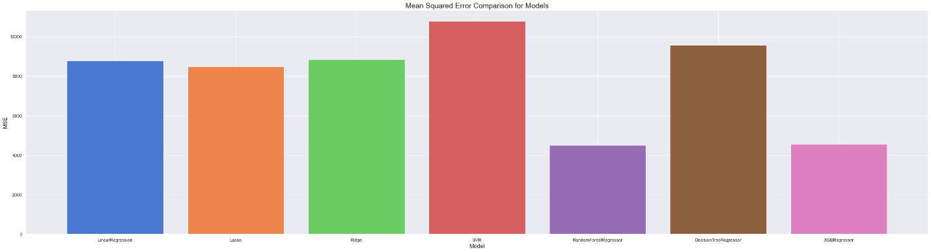
Performance Evaluation:
Fig.12 RMSE scores
Fig.13 MAE Scores
The RMSE score measures the square root of the average squared difference between the predicted and actual values. The lower normalized RMSE values show a better fit. Like the train and test score, it is also evident here that Random Forest Regressor and XGBRegressor are the better performers as both the models have lower RMSE, MAE and MSE values.

Slide 17
Fig.14 MSE scores of the models
Through all the above performance metrics on our selected models, we could see that the R squared, Normalized RMSE , MAE and MSE values for Random Forest Regressor were about 51, 0.14, 48.7 and 4886 respectively and those for XGBRegressor were 50, 0.14, 48.7 and 4949 respectively.
Both the models had highly similar performance on the data, but we chose Random Forest Regressor as the best model for our data due to its reduced complexity.

Slide 18
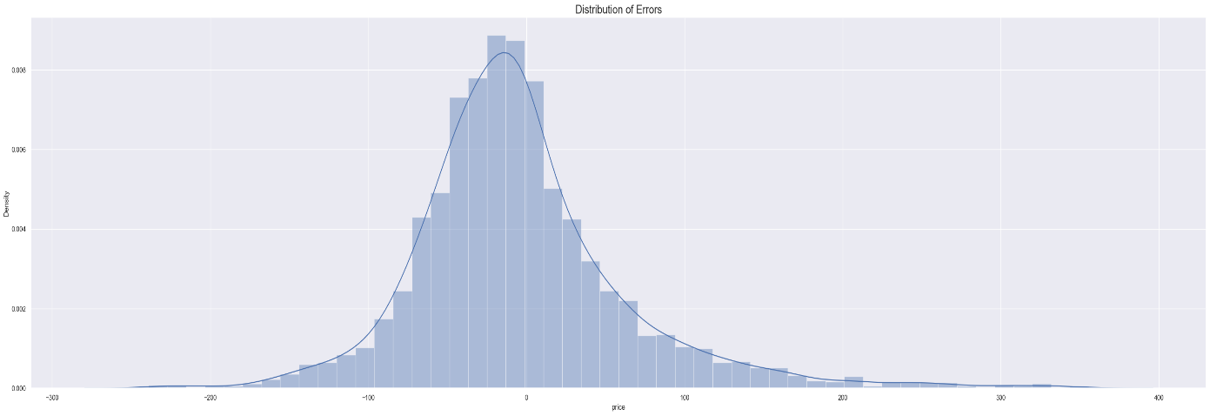
Residual Error:
Fig.15 Error Distribution
The distribution graph of the error i.e., the difference between actual and predicted values.
Through this, we could identify areas where the model's predictions deviate from the actual values.

Slide 19
Hyperparameter Tuning:
We proceeded to perform hyperparameter tuning to the winning model i.e., Random Forest Regressor to try and improve the model performance further and obtained the following results:
R squared | 83 (approx.)
Normalized RMSE | 0.079
MAE | 27.6
MSE | 1543 (approx.)
The hyperparameters used were 'max_depth': 30, 'max_features': 'sqrt', 'min_samples_leaf': 2, 'min_samples_split': 5, 'n_estimators': 150)

Slide 20
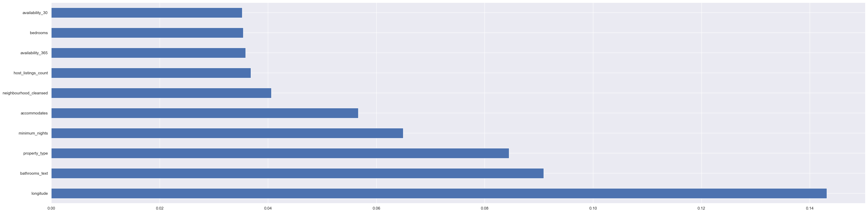
06 Project Results & Insights
Based on the cumulative analysis, we were able to achieve our primary goal of extensive data cleaning followed by model testing.
We could successfully correlate with the insights obtained from Exploratory Data Analysis.
Through this we were able to thoroughly understand the processing that happens behind the scenes.
We could see across different methods that random forest regressor was clearly the winner in predicting the price with minimal errors.
Fig.16 Top 10 features based on Random Forest Regressor

Slide 21
07 Key Challenges and Actions
 | Data Quality | Handling categorical Variables | Model Selection
Actions | Data profiling to identify missing values, outliers,duplicates and other issues. | We did data mapping for the features with the requirement Handled the existing imbalance between the variables | Identified nonlinearity in the data and tested relevant models Assessed complexity and efficiency to finalize on the winning model

Slide 22
Thank You

